Slide 1

Multi-Tasking –
We don’t have the brains for it!
Effective Learning for Growth
July 28, 2015

Slide 2
Multi-tasking – A way of life?
Most people think they’re good at it
People brag about it
Even see it in position descriptions
New norms
  Cell phones or tablets in use during meetings
  Making / Taking calls while driving
  24/7 availability
  “Open door” = Always interruptible

Slide 3
Multi-tasking – Can we really do it?
Stanford’s Ophir, Nass, & Wagner tested 300 students in 2014 study
  High and Low multi-tasker groups
  High were worse at
    Filtering out irrelevant information
    Short term memory retention
    Task switching

Slide 4
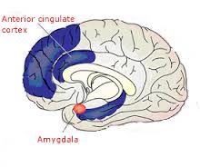
Multi-tasking – Can we really do it?
U Sussex study in 2014 found
  “people who frequently use several media devices at the same time have lower grey-matter density in one particular region of the brain compared to those who use just one device occasionally”
              “independent of individual personality traits, people who used a higher number of media devices concurrently also had smaller grey matter density in the part of the brain known as the anterior cingulate cortex (ACC), the region notably responsible for cognitive and emotional control functions”

Slide 5
Multi-tasking – How do we fake it?
Do 1 thing at a time – and switch between them very fast
  Go from A -> B -> C-> A -> D -> E-> C….
So what?
  There is loss-of-place and re-orientation cost
  It interferes with memory conversion
  It causes high and residual levels of stress
    What are physical / mental / emotional consequences?
  It lowers productivity and increases errors
  It interferes with real communication and relationships

Slide 6
Multi-tasking – Are we fooling anybody?
How often do you…
3+ Times / week | 1-2 times / week | 1-3 times / month | 5-8 times / year | 1-4 times / year | Never
5 | 4 | 3 | 2 | 1 | 0
Use a handheld device while driving?
Meet someone new and can’t recall their name within moments?
Respond to a message while in a meeting?
Not know what preceded “What do you think about that?”
Use your handheld device while walking?

Slide 7
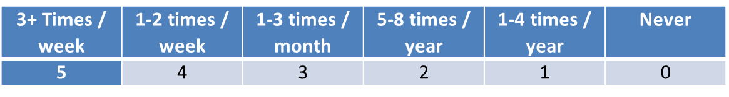
How often do you…
  Use your smartphone while with a colleague?
  Intend to do a task and instead become sidetracked?
  Show up at the wrong time or place for an appointment?
  Pretend you’re taking notes on a laptop or tablet while engaged in another task (like surfing the web or checking email)?
  Exit an elevator on the wrong floor because you were distracted?

Slide 8
How often do you…
  Have to re-read or re-watch material because you were not focused?
  Realize you aren’t giving someone your complete attention?
  Keep your smartphone on the table during meals and check it regularly?
  Feel compelled to respond to work demands when “off the clock?”
  Write an important note on a scrap of paper that is subsequently misplaced?

Slide 9
How often do you…
  Finish workdays with a sense that you didn’t get enough done?
  Lose your train of thought due to media interruptions?
  Hear from others that you’re easily or often distracted?
  Surf the web, answer email, do social media, or respond to messages while on a phone call?
  Have a lack of fulfillment and productivity, despite being busy?

Slide 10
What’s your score?
0-25 – Amazing!
26-50 – On the right track
51-75 – Hope springs eternal…
76 – 100 – Hit the Brakes!!

Slide 11
How can we not multi-task?
Single-tasking
Personal space
Choices, schedules, priorities
Expectations & Fences
Keep promises!
Practice, practice, practice

Slide 12
But what if the distractions come from inside?
Busy mind / monkey mind / afflictive emotions
Habits of thought are trainable
  Mindfulness
  ABCD
    Adversity, Belief, Consequence, Disputation
  Positive Intelligence Repetitions
Coaching helps

Slide 13
Q&A
Steve Callender, Ed.D.
President, Effective Learning for Growth
www.effectivelearningforgrowth.com
steve@effectivelearningforgrowth.com
(612) 708 -3933

